Slide 1
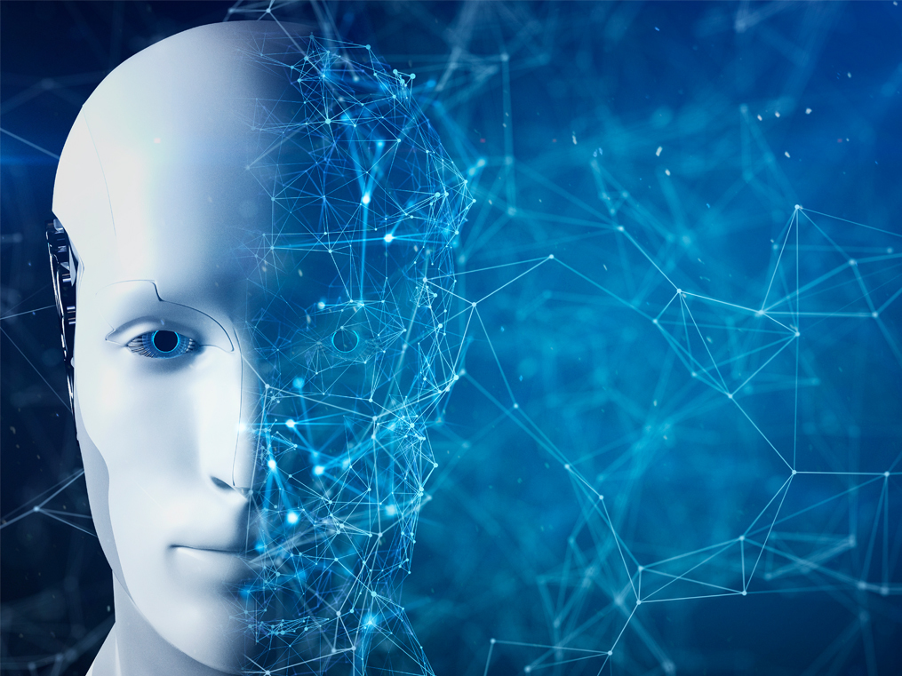
SOCIAL DISTANCING DETECTOR

Slide 2
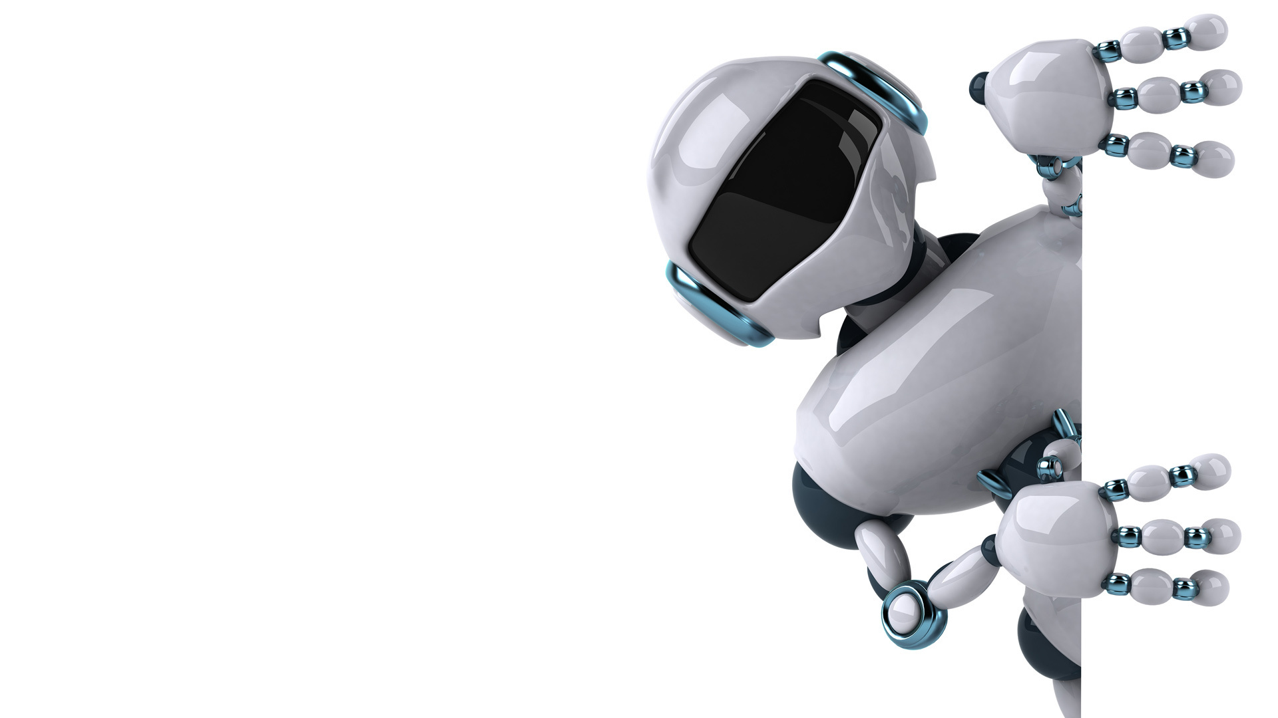
INTRODUCTION
Social Distancing – the term that has taken the world by storm and is transforming the way we live. Social distancing has become a mantra around the world, transcending languages and cultures.
The biggest cause of concern is that COVID-19 spreads from person to person through contact or if you’re within close proximity of an infected person.
Given how densely populated some areas are, this has been quite a challenge. So, we built a tool that can potentially detect if the distance between two people is dangerously close.
This can be used by governments to analyze the movement of people and alert them if the situation turns serious. ​

Slide 3
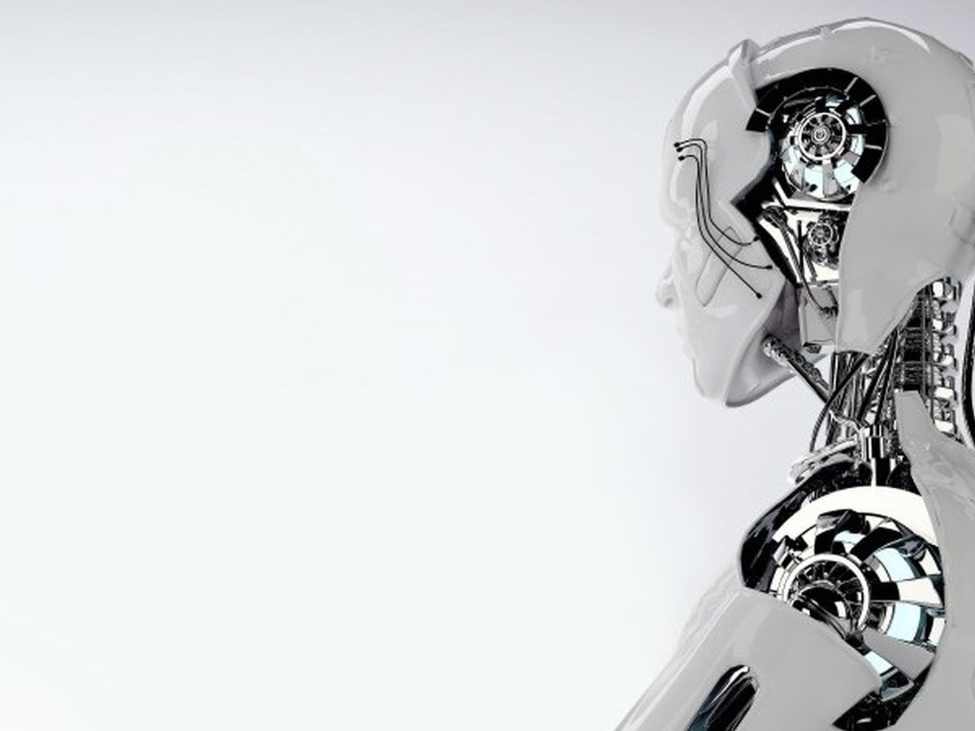
Concepts Used In The AI Model
Computer Vision
OpenCV
YOLO
COCO
Deep Neural Network
Model WorkFlow

Slide 4
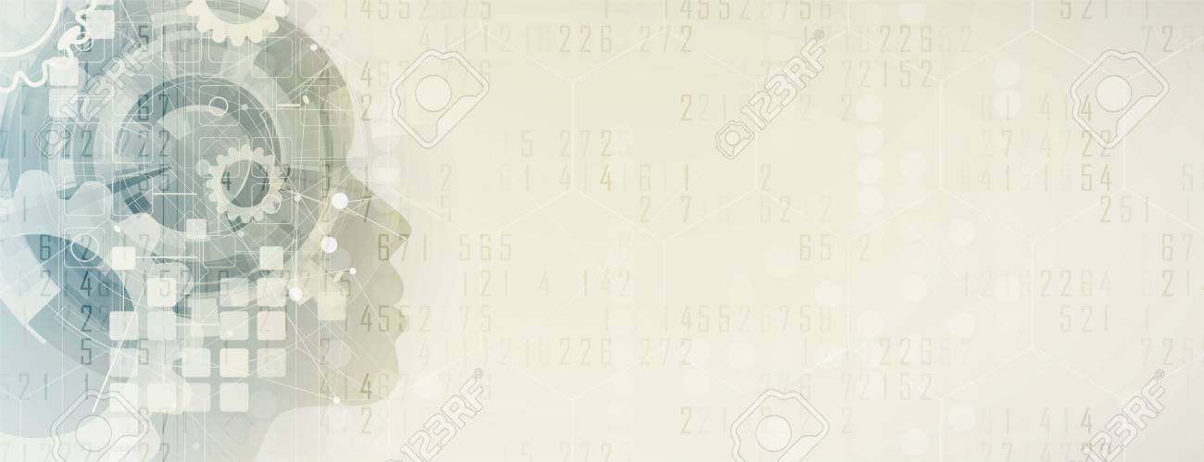
COMPUTER VISION
Computer Vision, customarily called as CV is a field of study that works on developing techniques to help computer to “see” and understand the content of digital images.
Computer vision is thus an automated extraction of information from images which can include anything from 3D models, camera position, object detection and recognition to grouping and searching image content.
As studying biological vision requires understanding of the perception of organs like eyes and interpretation of perception within the brain. Also, visual world has huge inherent complexity which makes the problem more challenging.
Much progress has been made in the field but there is still a long way to go.

Slide 5

Open CV
Open Source Computer Vision Library is an open source computer vision and machine learning software library. OpenCV was built to provide a common infrastructure for computer vision applications and to accelerate the use of machine perception in the commercial products.
Currently OpenCV’s deployed uses span all around the world from :-
Stitching street view images together​
Detecting intrusions in surveillance video in Israel​
Monitoring mine equipment in China​
Helping robots navigate​
Pick up objects at Willow Garage​
Detection of swimming pool drowning accidents in Europe​
Running interactive art in Spain and New York​
Checking runways for debris in Turkey​
Inspecting labels on products in factories around the world​
Face Detection in Japan
The library is used extensively in companies, research groups and by governmental bodies.

Slide 6
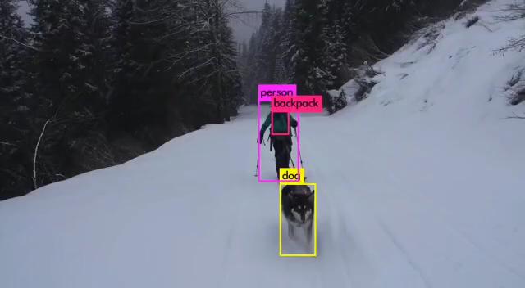

Slide 7
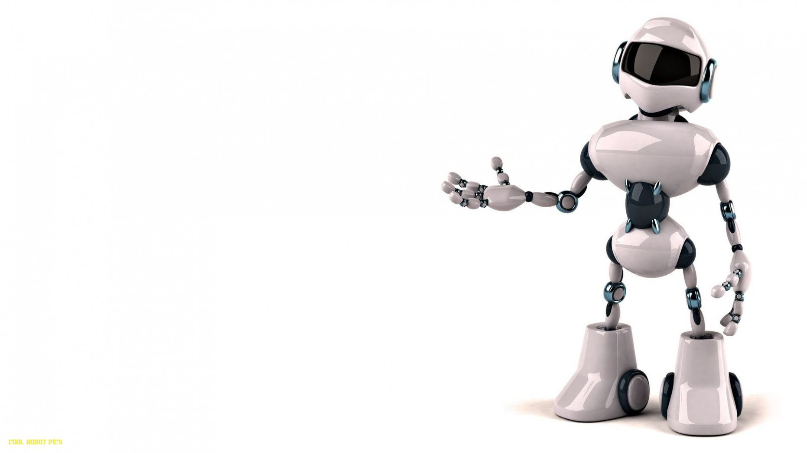
YOLO
YOLO stands for You Only Look Once.
It applies a single neural network to the full image and divides the image into regions and predicts bounding boxes and probabilities for each region.
It also makes predictions with a single network evaluation unlike systems like R-CNN.
This makes it extremely fast, more than 1000x faster than R-CNN and 100x faster than FAST R-CNN.
Running YOLO can be made more interesting also run it on the input from a webcam!​

Slide 8
COCO
Common Objects in Context (COCO) is a large-scale object detection, segmentation and captioning database that aims to enable future research for object detection.
COCO has several features:​
Object segmentation​
Recognition in context​
330K images (>200K labeled)​
1.5 million object instances​
80 object categories​
91 stuff categories​
5 captions per image​
250,000 people with key points

Slide 9

Deep NEURAL NETWORK
Deep Learning is a subfield of machine learning concerned with algorithms inspired by the structure and function of the brain called artificial neural networks.
The neural network needs to learn all the time to solve tasks in a more qualified manner or even to use various methods to provide a better result.
When it gets new information in the system, it learns how to act accordingly to a new situation. Learning becomes deeper when tasks you solve get harder.
Deep neural network represents the type of machine learning when the system uses many layers of nodes to derive high-level functions from input information.

Slide 10
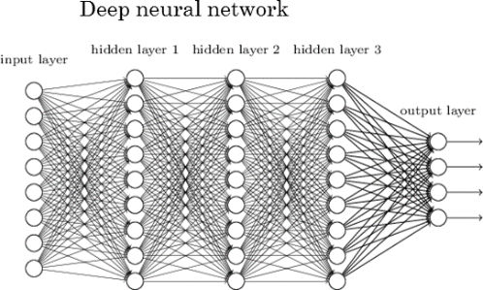
A Deep Neural Network is beneficial when you need to replace human labor with autonomous work without compromising its efficiency.
Fig. Structure of a Deep Neural Network

Slide 11
Industry Usage
SENSTIME - A Chinese company created a system of automatic face recognition system to identify criminals, which uses real-time cameras to find an offender in the crowd.
PONY-AI - An American company is another example of how you can use DNN. They developed a system for AI cars that can work without a driver. It recognizes people, road signs and other markings like trees, and other important objects.

Slide 12

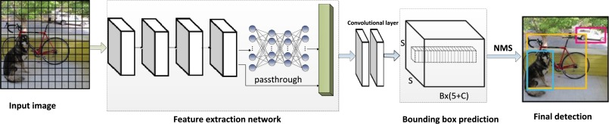
MODULE WORKFLOW
1. OBJECT DETECTION ​-
Consider an image​
Pass an image to CNN​
Extract the features of an image​
Select ROI features using Region Proposal Network (RPN)​
For each ROI feature, pass features to a classifier & regressor​

Slide 13
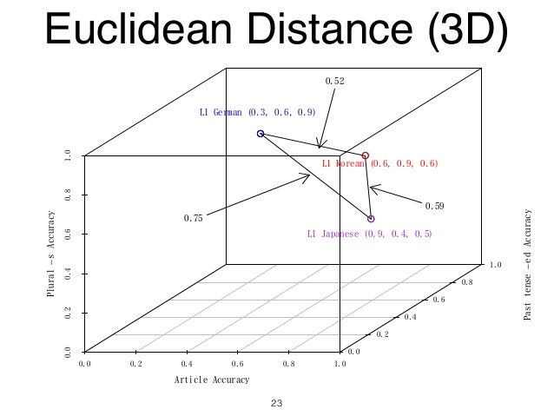
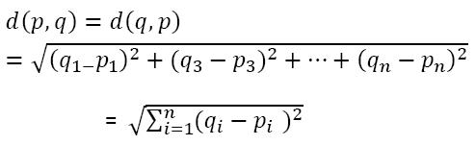
MODULE WORKFLOW
2. CALCULATING THE DISTANCE​ -
This function is used to calculate the distance between two different points (a and b) in an image (single frame of a video). The two points denote the center of the individuals detected in the video. The distance that is calculated is the Euclidean Distance
Euclidean Distance –
The Euclidean distance between two points in either the plane or 3-dimensional space measures the length of a segment connecting the two points.
The formula used to calculate the Euclidean Distance between 2 objects in 3d plane is -

Slide 14
MODULE WORKFLOW
3. IMAGE PROCESS FUNCTION​ -
This is the most complex function in our program. In this function, The argument is a single frame of the video. For every iteration, each frame of the input video gets processed along with the social distancing detection between each individual in a crowd and is returned to the main function.
4. MAIN FUNCTION -
​We now come to the final part of the code. In this, the input video is separated into many single frames on which the functions defined above will be performed.​
Once that is done, each output frame is received and combined together to create the output video.​ Longer the video, longer will be the time taken to process the video. ​ ​

Slide 15
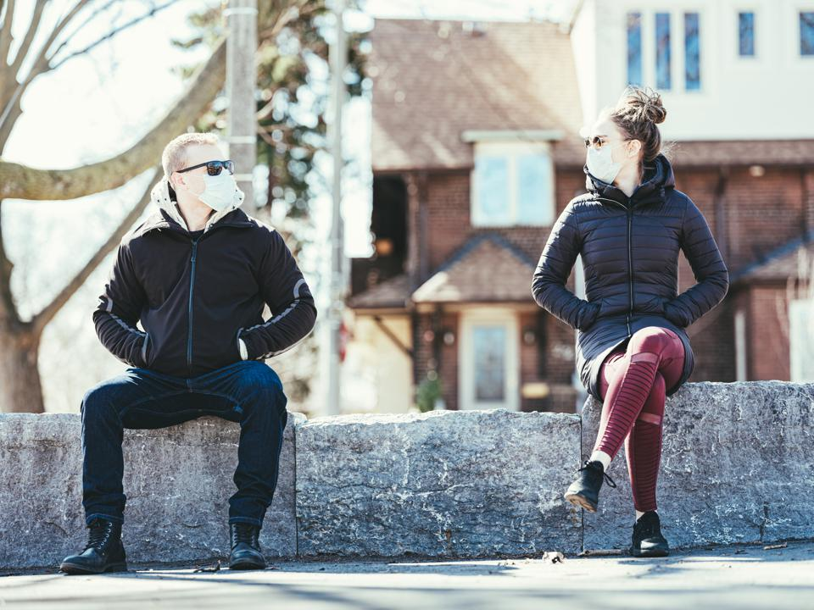
SOCIAL DISTANCING
in the Post-COVID era is one such practice that will be followed for many days to come by.
Let us all be safe and stay healthy.
Till then, Happy Machine Learning!
THANK YOU

Slide 16
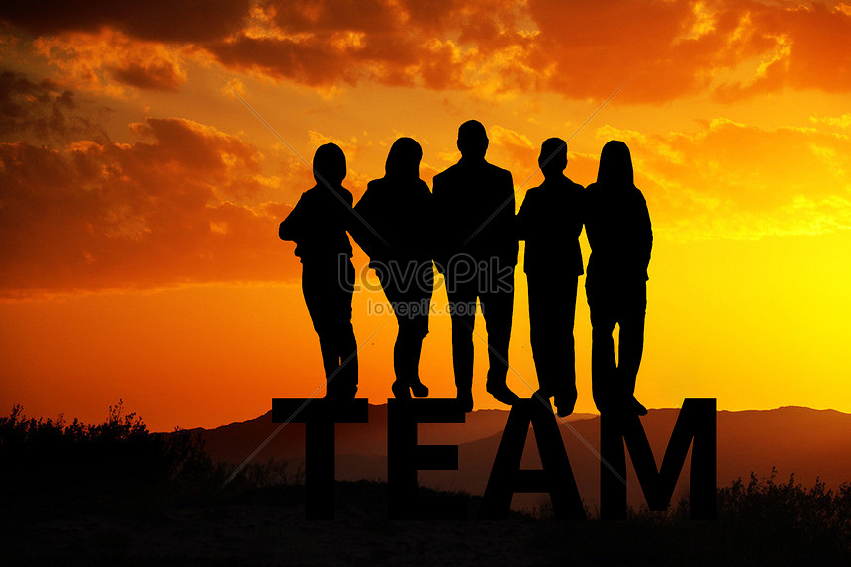
MEET THE TEAM
Namrata
Rahul Raj Pandey
Sidhya Vidya Singh
Meghna Chandwani

